Slide 1
Week 8: COLOR
A SET OF CODES GENERATED BY THE BRAİN
How do you quantify?
How do you use?

Slide 2
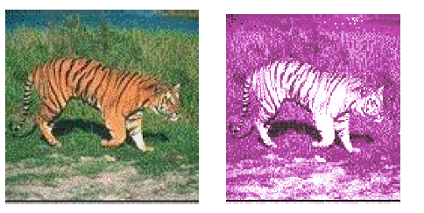
Color is crucial to represent image content
Tiger in forest? Cat on a rug?

Slide 3
What is Color?
Color is an electromagnetic waveform, in Physics
Color is the coded light by our brain, in Neuroscience

Slide 4
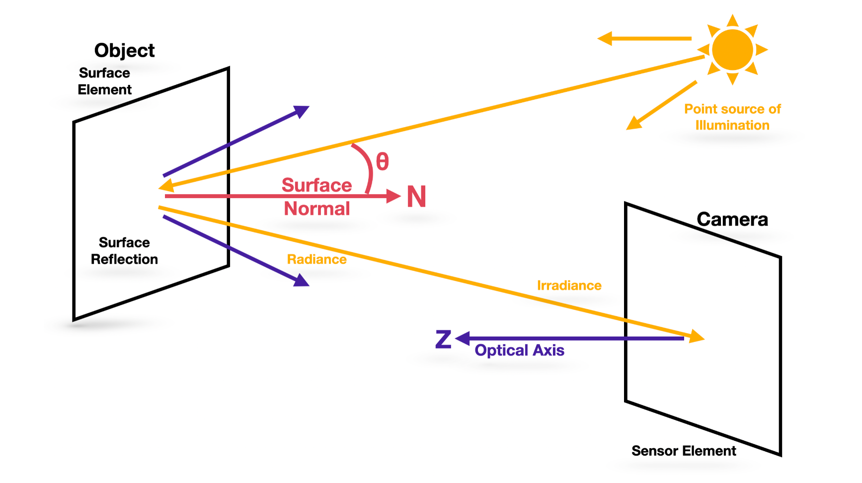
Color Formation
The source of illumination
The spectral reflectance of the object’s surface:
Sensory device

Slide 5
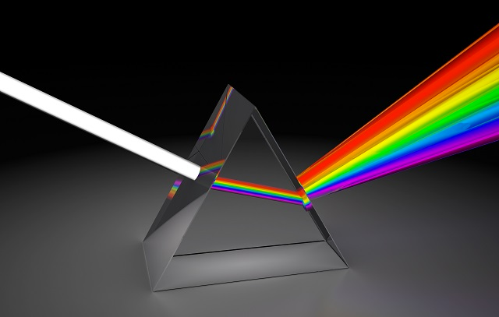
White Light
The electromagnetic waveform in the visible spectrum, composed of approximately equal energy in all wavelengths.

Slide 6
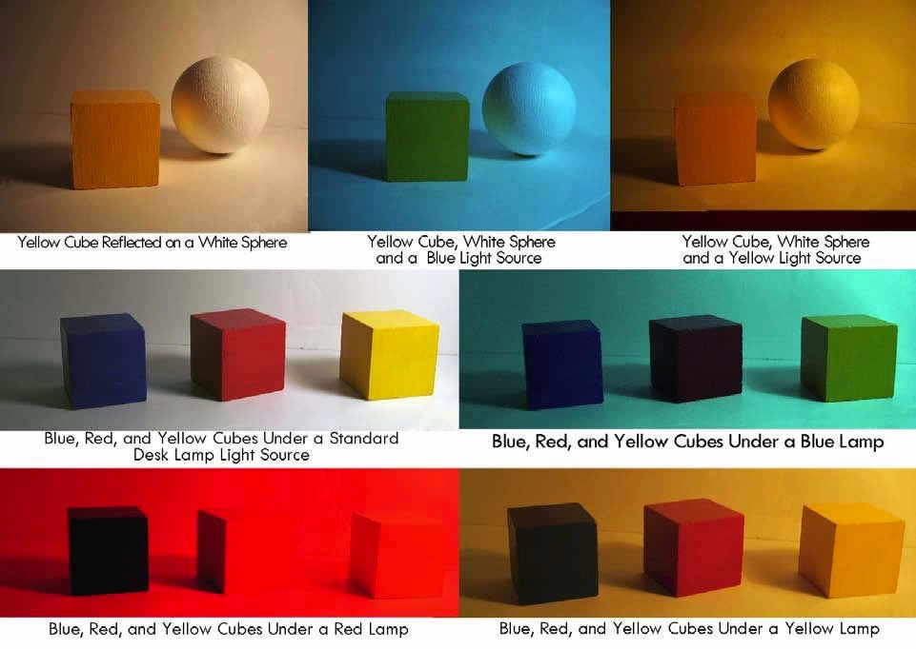
What is yellow object?
A yellow object has a surface material that reflects wavelength corresponding to yellow, when illuminated by white light

Slide 7
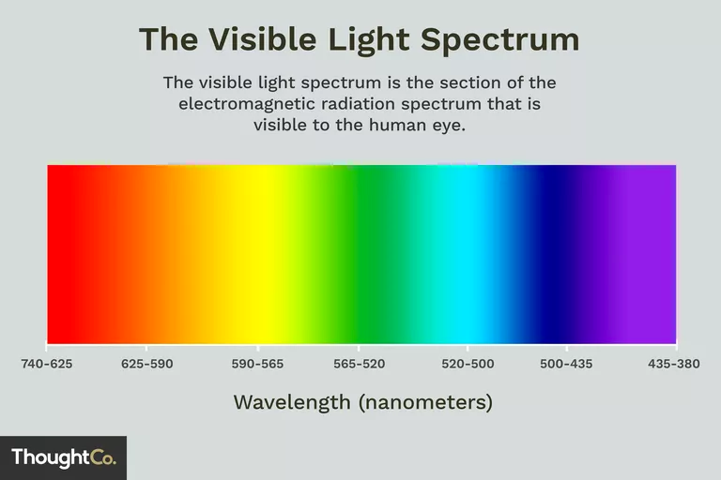
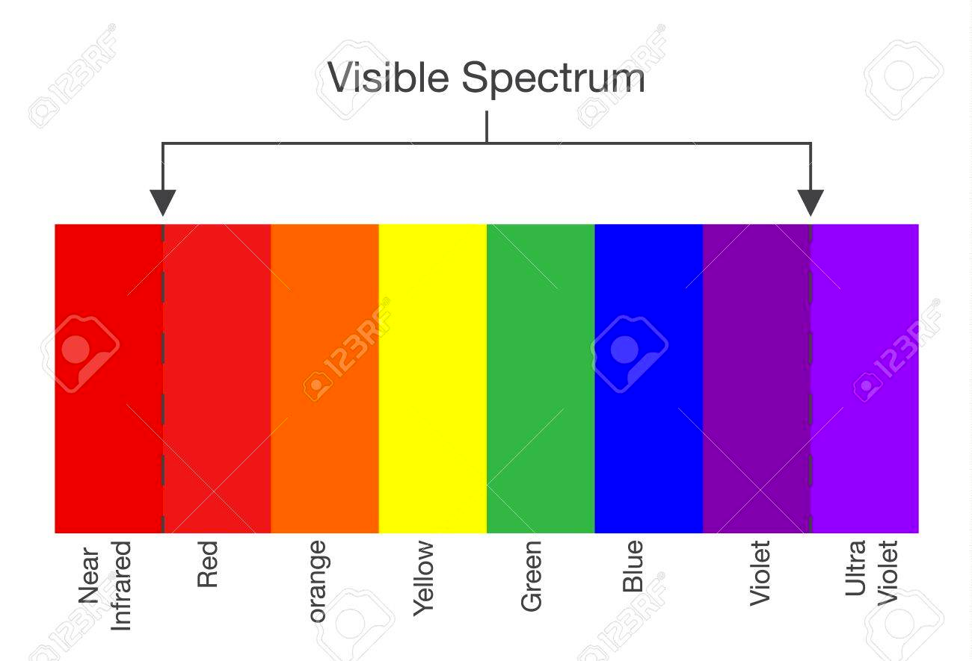
Color as we perceive
Q: How does the human visual system process the irradiated light from the objects to generate color?

Slide 8
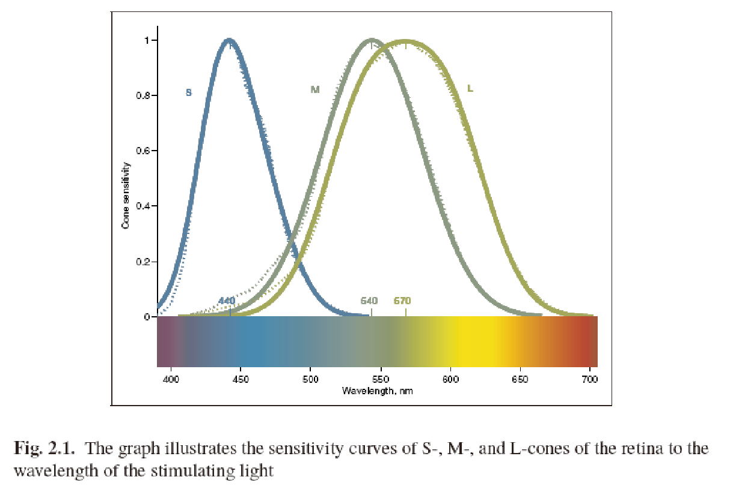
Three Color System: cones work as tiny filters

Slide 9
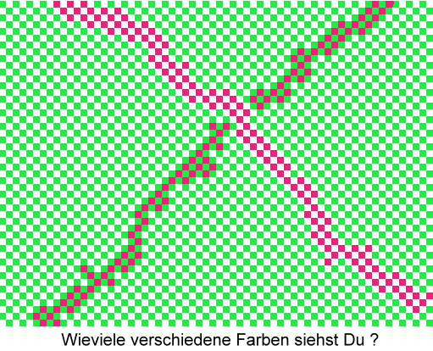
Color Generation in Human Brain,
Mixes three primary colors to generate the other color
Takes the difference of the two neighboring color codes to assign the color of an object

Slide 10
Mathematical Representation of Color
Trichromatic Theory (Young-Helmholtz)
” Almost all the colors can be generated from three independent vectors, in three dimensional color space”

Slide 11
Color Systems in 3-D Space
RGB is an additive system used for displays.
Black = [0, 0, 0]
CMY is a subtractive system for printing.
Black = [L-1, L-1, L-1]
HSI is a good perceptual space for art, psychology, and image processing.
YIQ used for TV is good for compression.
…..
etc.

Slide 12
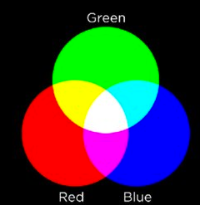
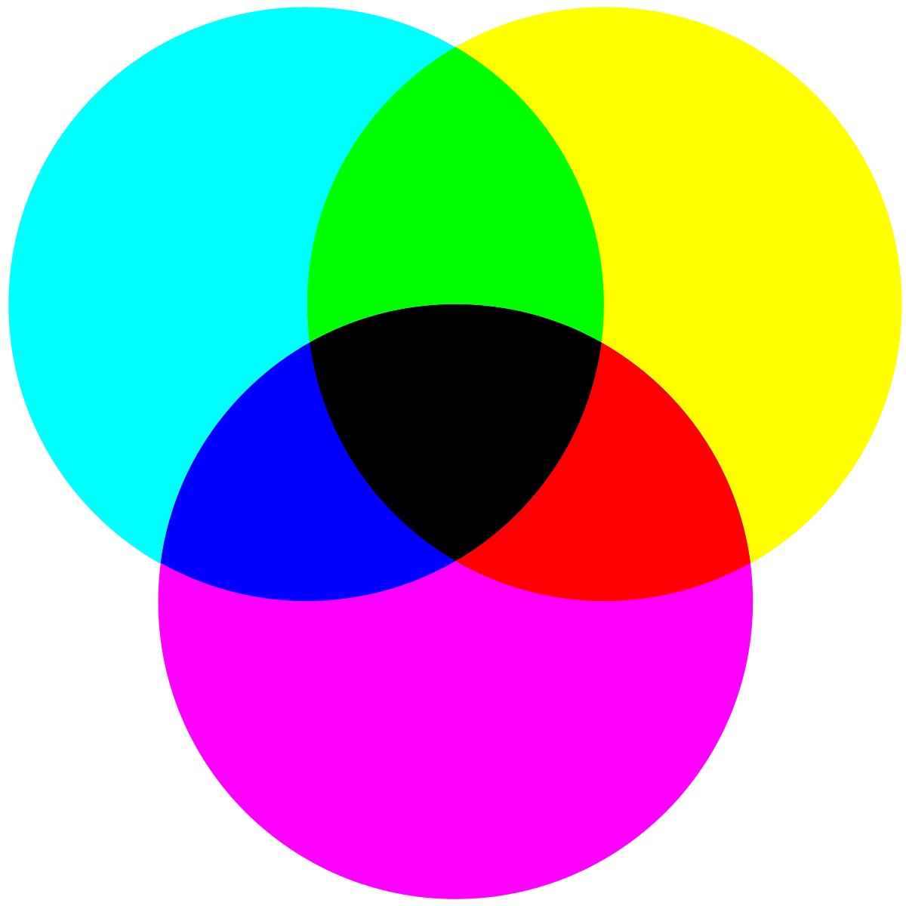
RGB vs. CMY Systems
RGB: Add colors to black
CMY: Subtract colors from white

Slide 13
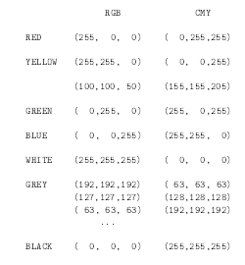
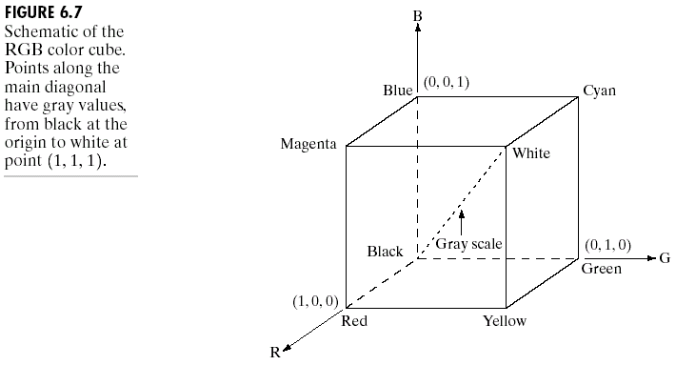
RGB and CMY Color Spaces
A point on gray scale c_{i} has r_{i} = g_{i ,} = b_{i}

Slide 14
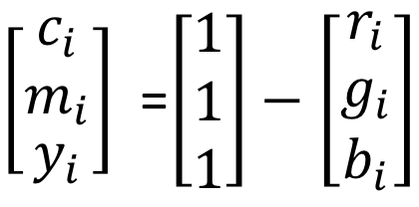
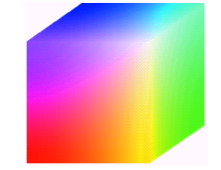
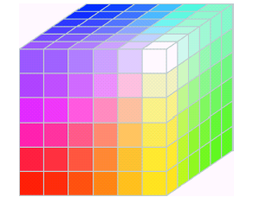
Mapping between RGB and CMY Systems
Continuous Color Cube
Digitized Color Cube: RGB safe colors

Slide 15
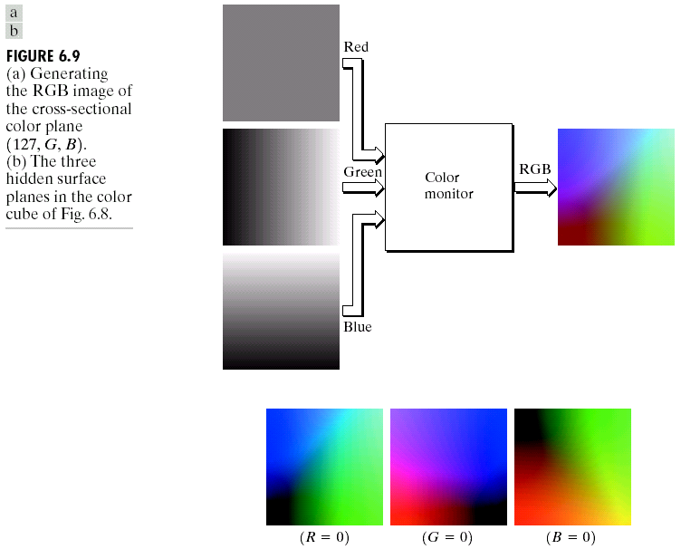
RGB Color System is Additive

Slide 16
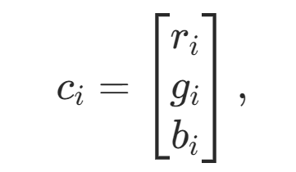
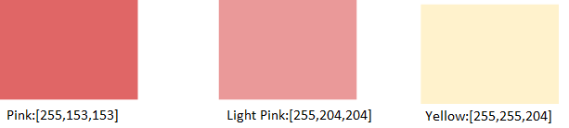
Can you decompose a color into R, G and B components

Slide 17
Can you decompose a color into R, G and B components

Slide 18
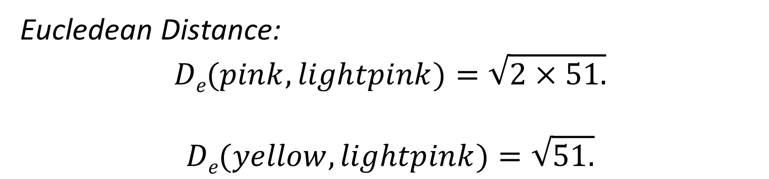
Which one is more similar to light pink?
Eucledean Distance:
$$De​(pink, lightpink)=\sqrt{2×51​.}$$
$$De​(yellow,lightpink)=\sqrt{51​.}$$

Slide 19
Fact: HVS does not work with vector operations
Cones: Cromaticity, Hue and saturation
Rodes : Gray Scale brightness values

Slide 20
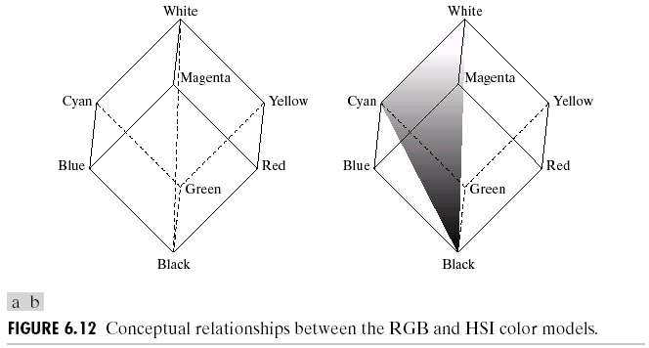
HSI Color Coordinate System

Slide 21
Pull the color cube from the black and White ends

Slide 22
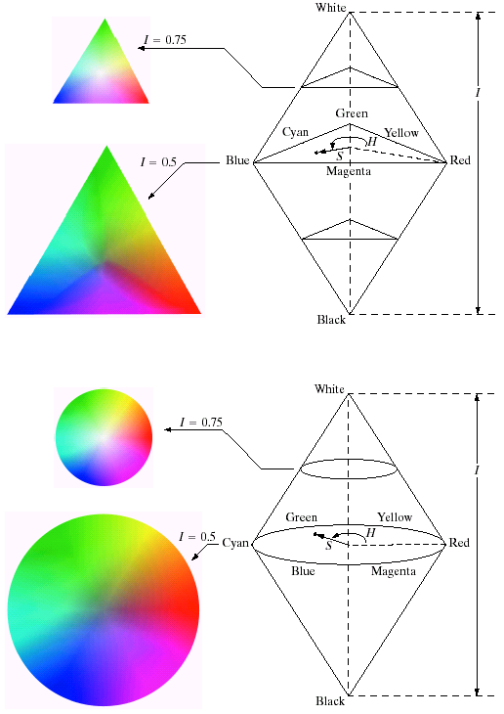
Pad it from the sides to form triangular or circular cross sections, called color plane
Hue: Pure colors, such as red, orange, yellow… H= (0, 360⁰)
Saturation: Relative purity of a color measured by hue S=(0,1).
Intensity: Brightness value, I = (0, L-1)
Normalize HIS coordinates to (0,1)

Slide 23
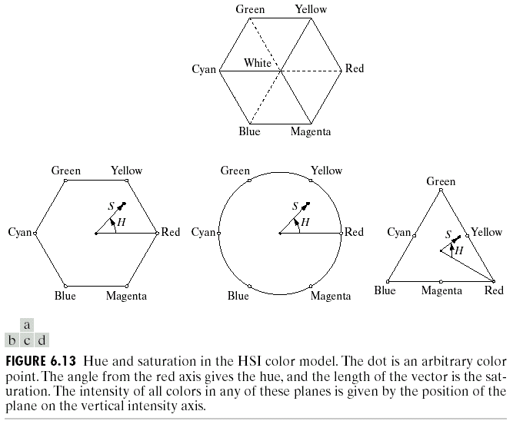
Or form hexagonal cross sections

Slide 24
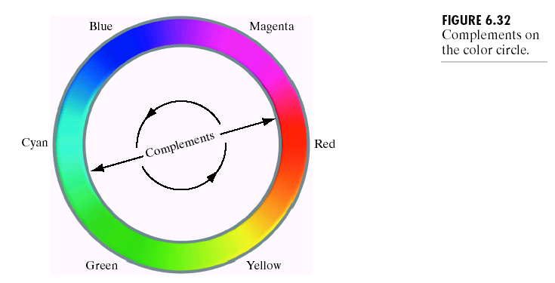
Largest Color Plane has the highest HUE around the circle

Slide 25
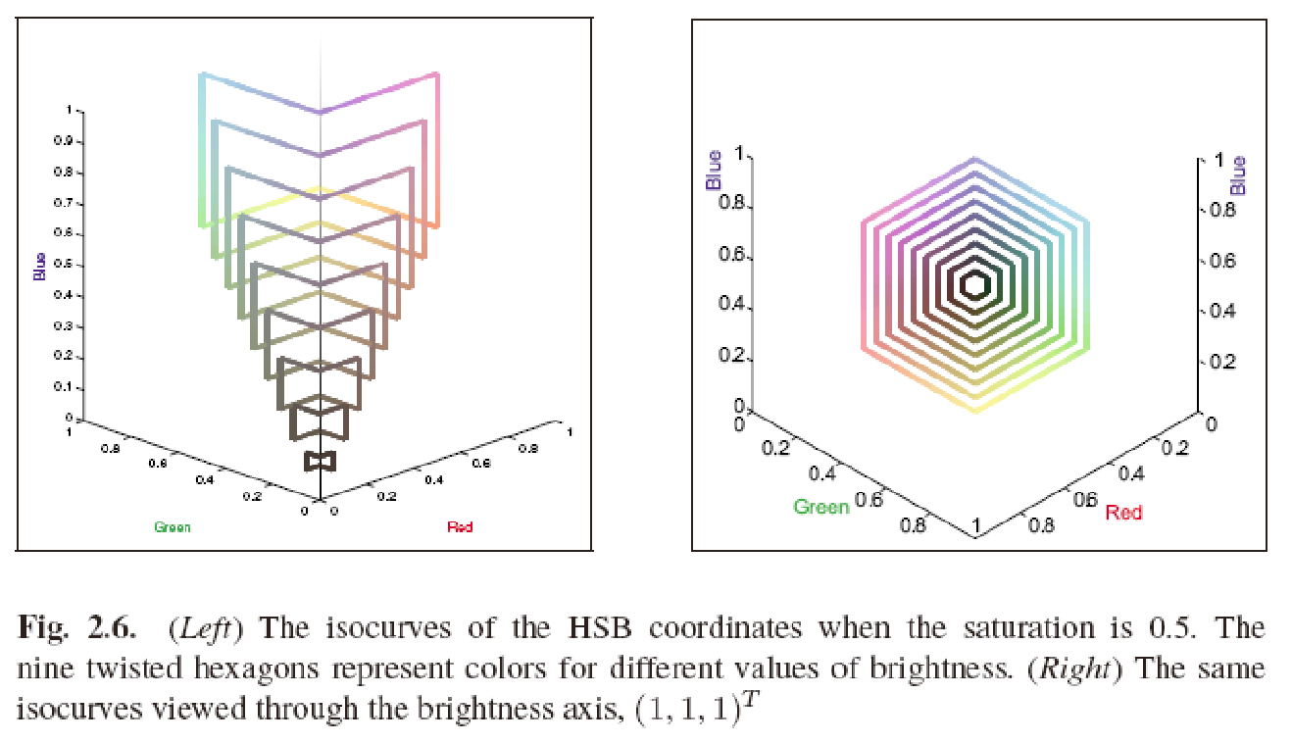
Deform HIS space back to RGB (CMY) Space Generate 9 different color planes of HIS space for a fixed saturation in the deformed RGB (CMY) Space

Slide 26
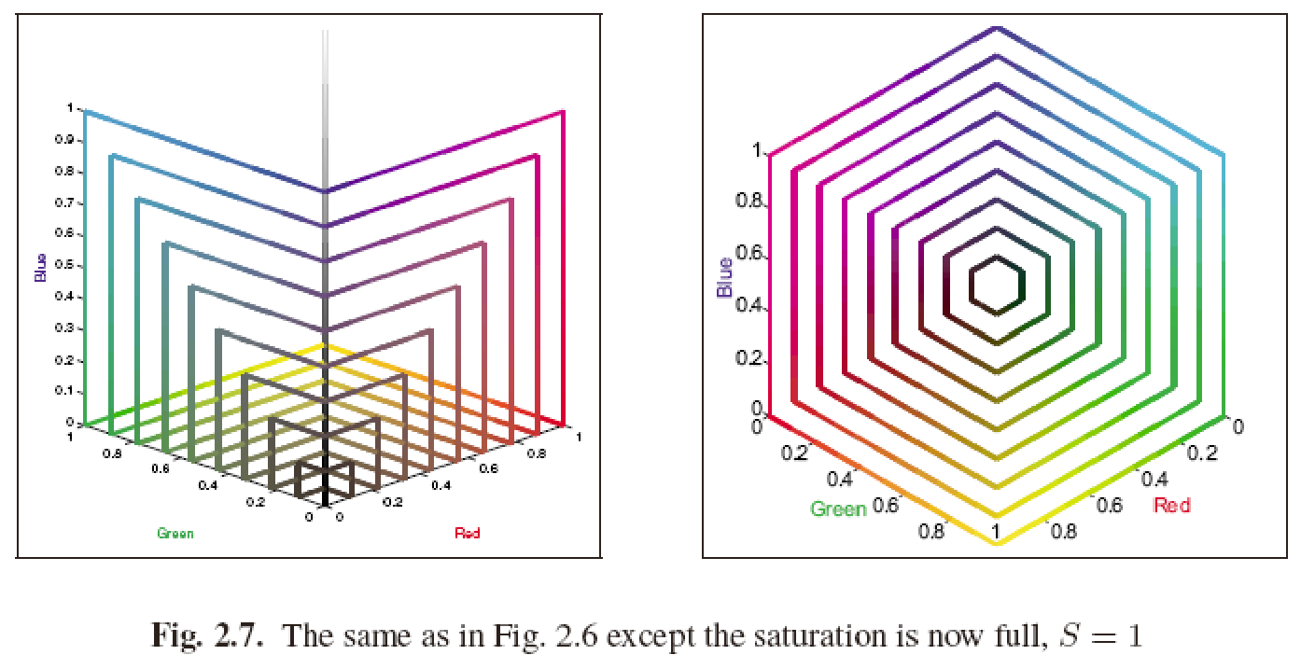

Slide 27
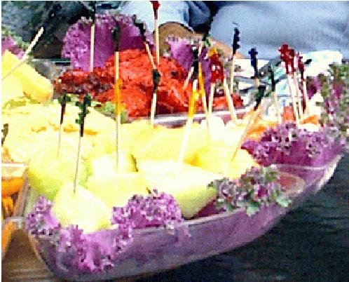
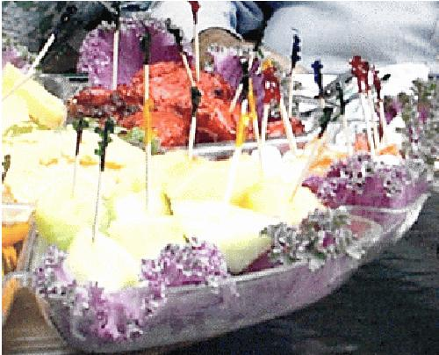
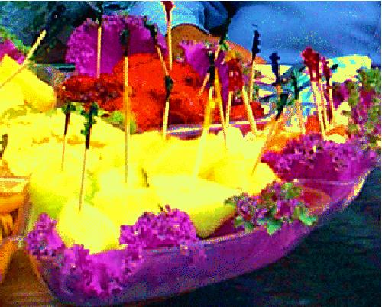
Editing saturation of colors
(Left) Image of food originating from a digital camera;
(center) saturation value of each pixel decreased 20%;
(right) saturation value of each pixel increased 40%.

Slide 28
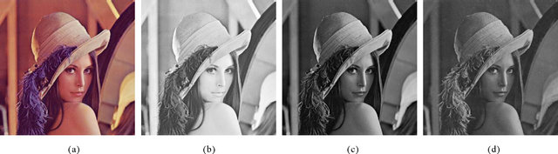
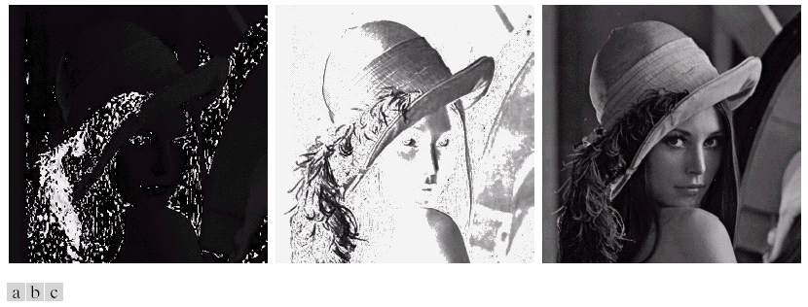
RGB and HSI Representation of Lena

Slide 29

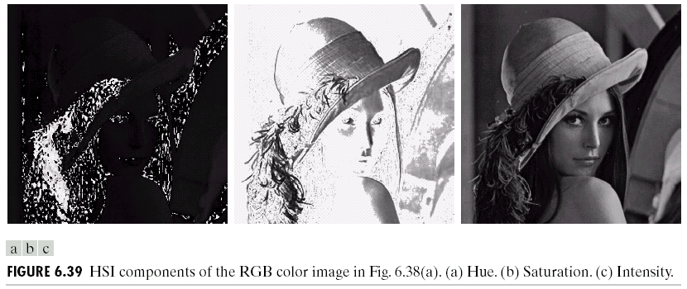
Intensity carries most of the information

Slide 30
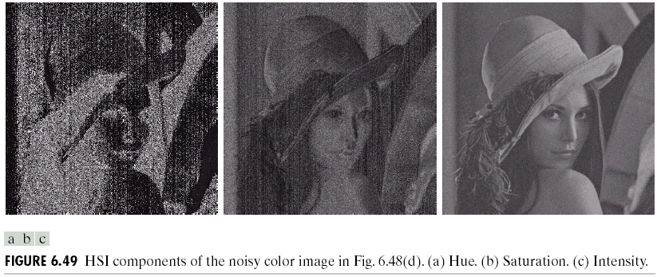
Effect of Noise in HSI Channels

Slide 31
YIQ and YUV Color Spaces for TV signals
Have better compression properties
Separates Luminance and chrominance
Luminance Y
Chrominance I, Q
Humans are more sensitive to Y than I,Q
Luminance Y is encoded using more bits than chrominance values I and Q
Luminance used by black/white TVs
All 3 values are used by color TVs
YUV encoding are used in some digital video and JPEG and MPEG compression

Slide 32
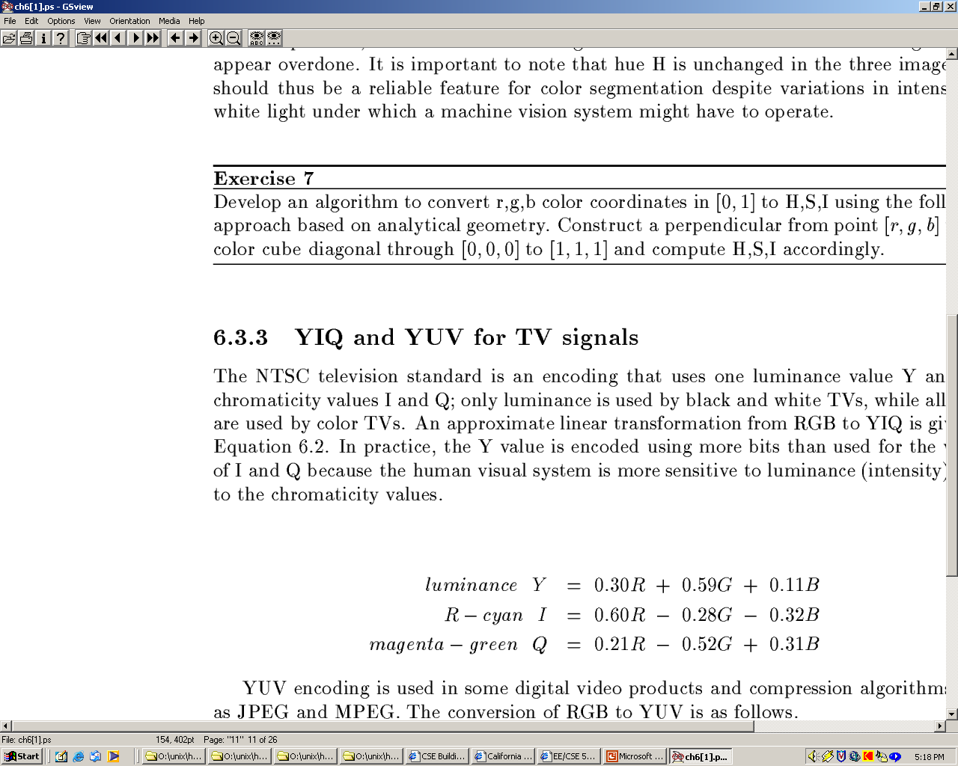
Conversion from RGB to YIQ
An approximate linear transformation from RGB to YIQ:
We often use YIQ for color to gray-tone conversion.

Slide 33


Conversion from RGB to HSI

Slide 34
Can we define a color system in a two dimensional space, where colors can be represented for a given intensity value?

Slide 35
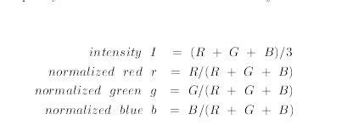
Color Normalization
Add r, g and b

Slide 36
Color Normalization
r+g+b=1.

Slide 37
Color Normalization Enables to reduce the dimension
r+g+b=1.
Thus, we can define a two dimensional space spanned by r and b.
We can get g (green) value from
g=1-r-b.

Slide 38
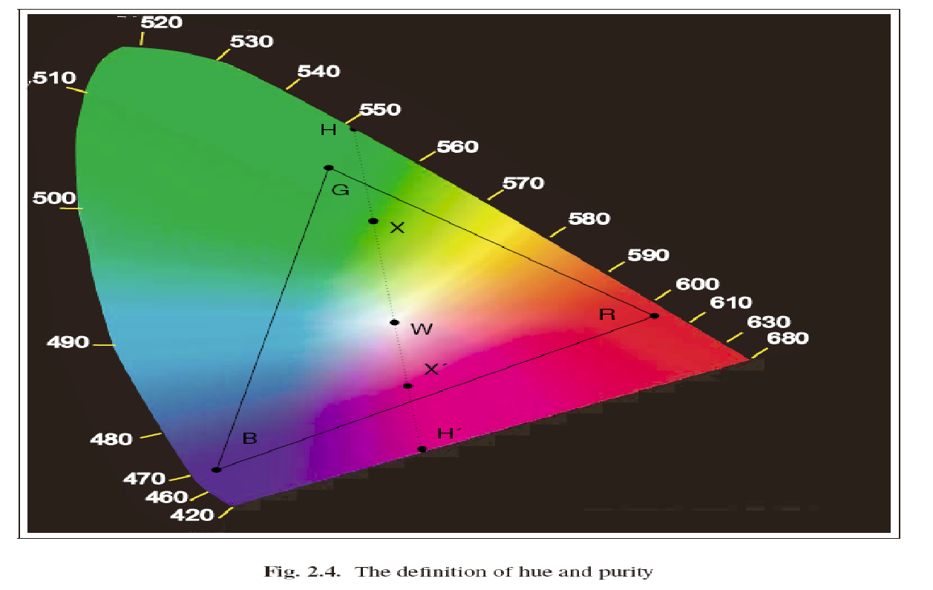
Choromaticity: Normalize r+g+b=1 Plot r (red) vs. b (blue) and compute the corresponding g (green)
Good for generating colors, inside the triangle (HDTV)
Pure colors are at the boundary
Inside the Gamut is the mixture of less saturated colors

Slide 39
Color Image Processing Examples
Histogram Processing
Content-based Image retrieval
Object Recognition
Color Segmentation
Face Detection
Image Enhancement

Slide 40
Histogram Processing
Histogram is fast and easy to compute.
Image size can easily be normalized by histograms, so that different image histograms can be compared.
Can match color histograms for database query, object detection or recognition.

Slide 41
How to make a color histogram?
Create three 1-D Histograms
Create 2-D Histograms, by using Chromaticity Diagrams, h(r,b)
Create 3-D Histograms, h(r,g,b)
Create a single pseudo color code between 0 and (L-1) by using RGB color bits

Slide 42
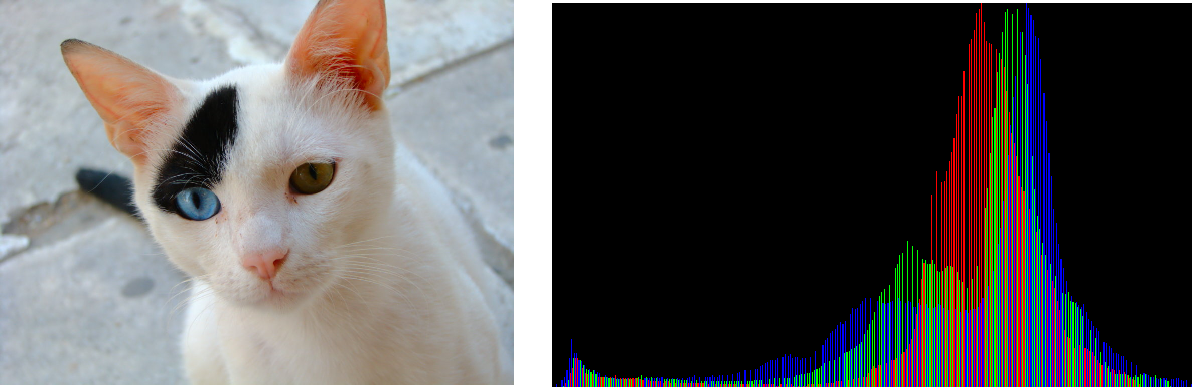
Three independent Histograms

Slide 43
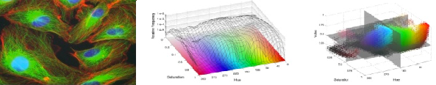
2-D and 3-D Histograms

Slide 44
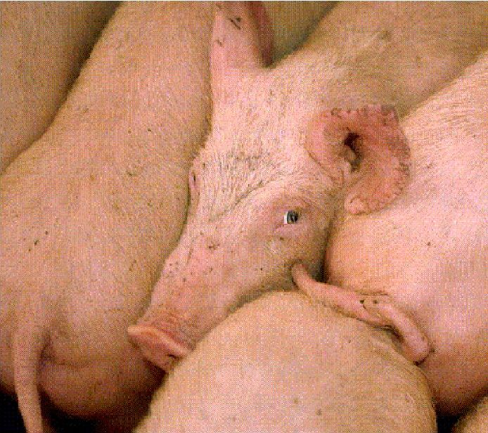
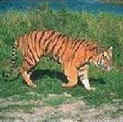
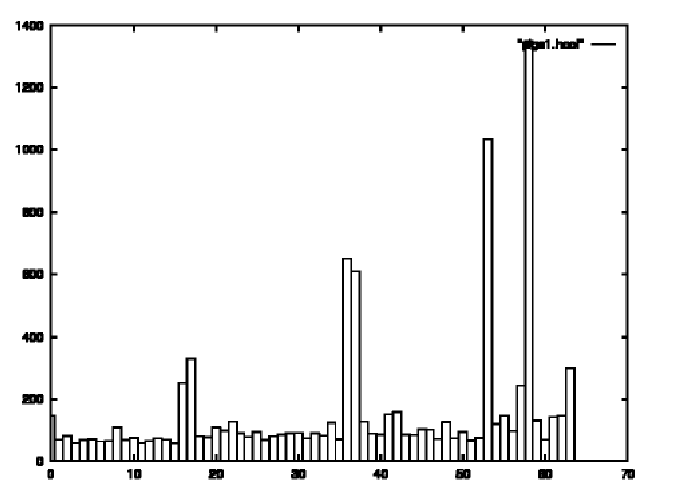
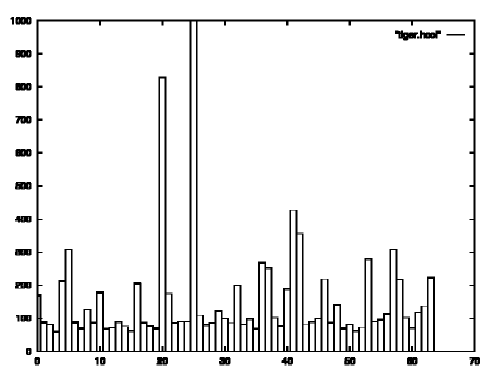
Use the color codes to generate bin histograms: Take 2 most significant bit in R,G,B obtain 2⁶=64 bins

Slide 45
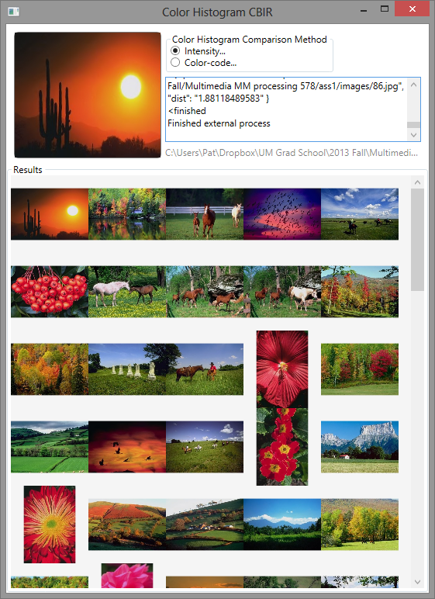
2. Content Based Image Retrieval: Retrieve Similar Images

Slide 46
How to measure Image Similarity?
Kullback-Leibler Divergence
Sum of Square Error
Histogram Intersection and Match

Slide 47
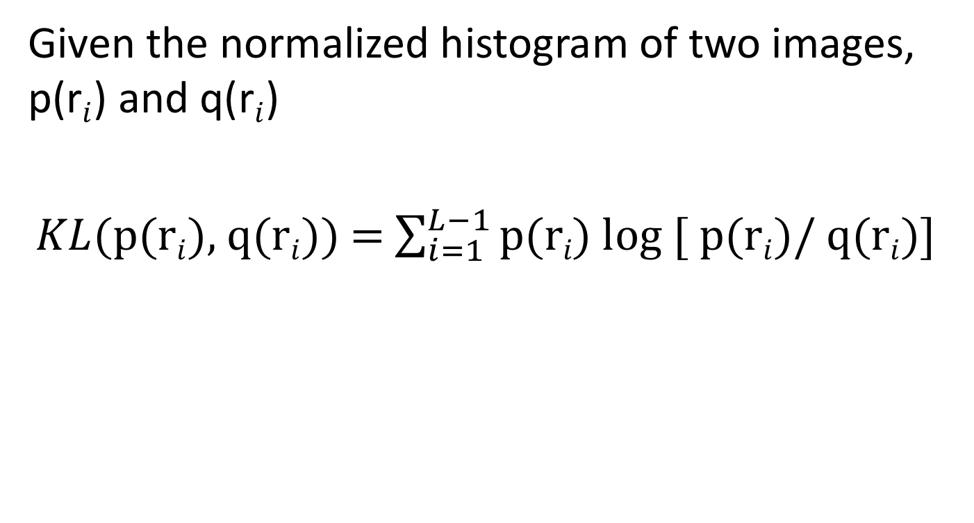
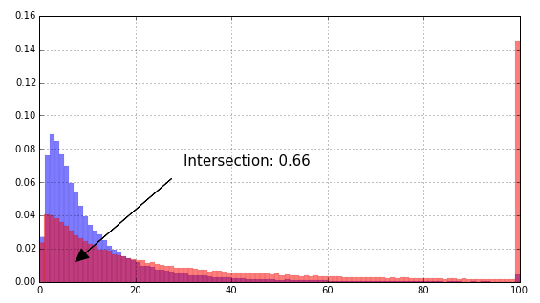
Kullback-Leibler Divergence

Slide 48
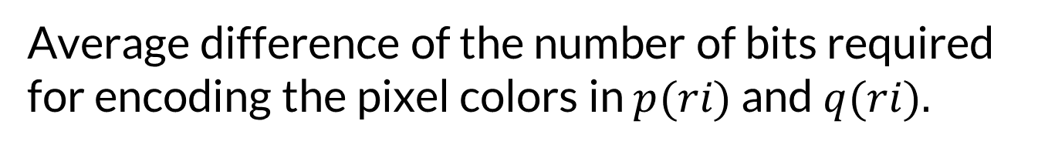
Kullback-Leibler Divergence
Average difference of the number of bits required for encoding the pixel colors in $p(ri​)$ and $q(ri​).$

Slide 49
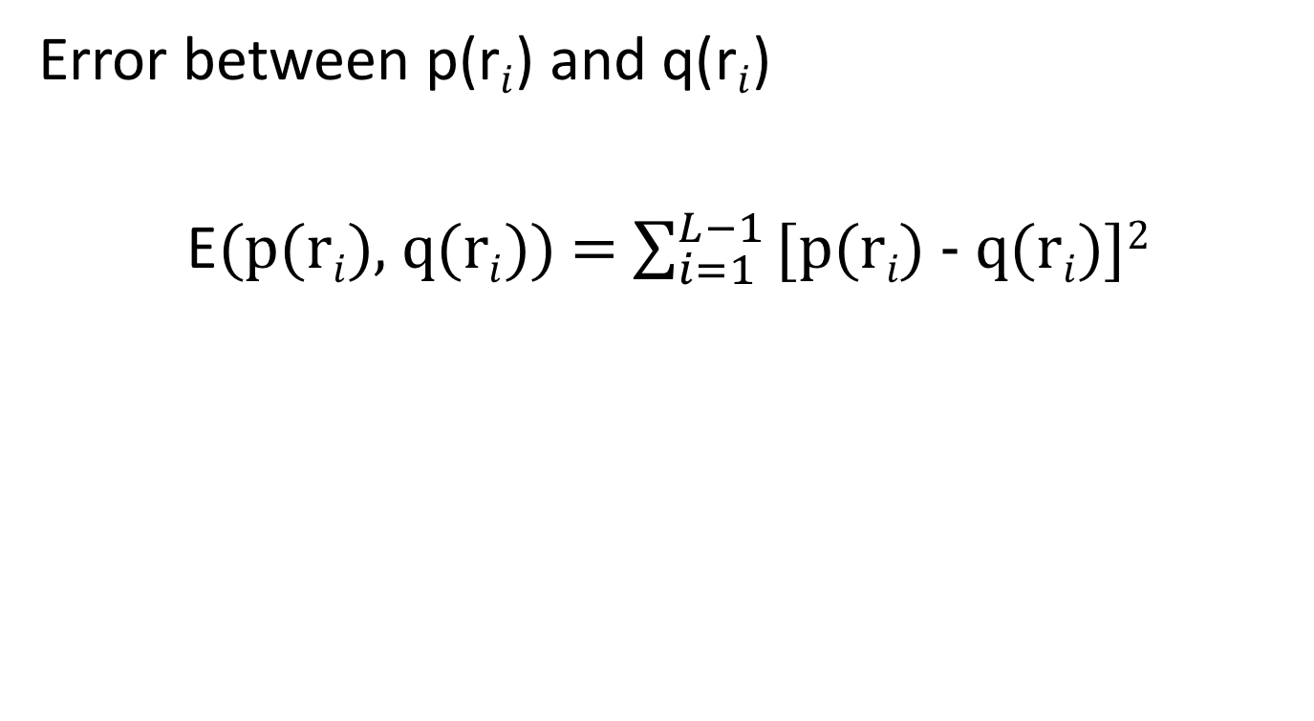
Sum of Square Error

Slide 50
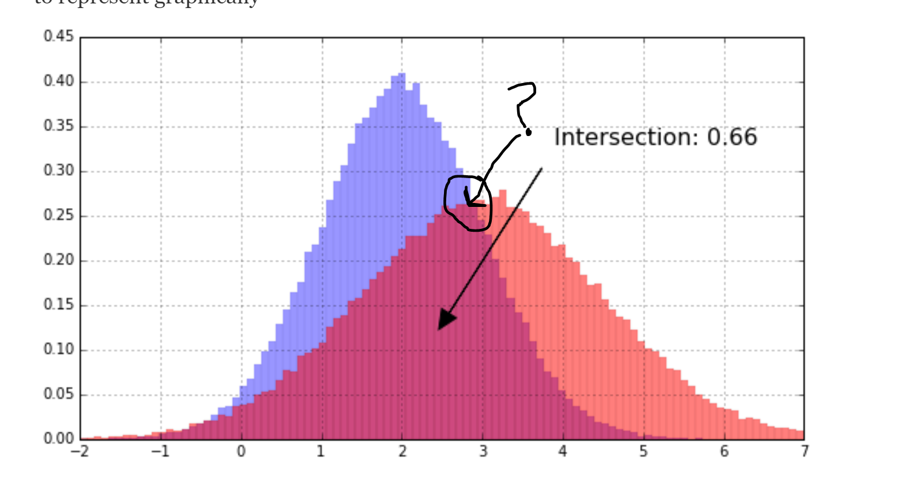
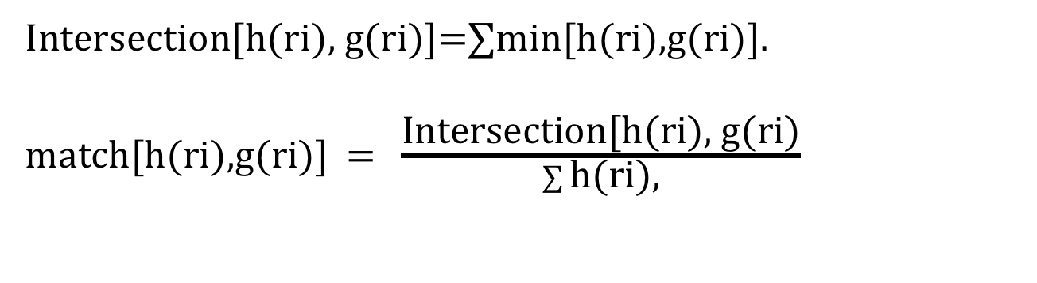
Histogram Intersection and Match

Slide 51
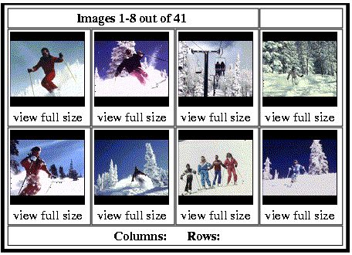
2. CBIR: Content Based Image Retrieval
Top left image is query image. The others are retrieved by having similar color histogram

Slide 52
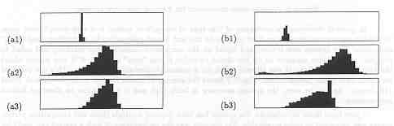

3. Object Recognition: Apples versus Oranges
H
S
I
Separate HSI histograms for apples (left) and oranges (right) used by IBM’s VeggieVision for recognizing products at the grocery store checkout station

Slide 53


4. Color Clustering Given an image, group the colors in the palette of L colors into K colors with respect to a similarity predicate, such that the similar colors fall into the same group. K<L,

Slide 54

K-Means Color Clustering Method: Clusters the similar colors into K- Groups, in d-Dimensional color space

Slide 55


K-Means Clustering Algorithm:
Set , iteration count, $ic=$ $1$
2. Choose randomly a set of $K$means , $m1\left(1\right), …, m_{K}\left(1\right)$
3. For each color vector, $x_{i}$, compute the Eucledean distance:
D$\left(x_{i},m_{k}\left(ic\right)\right) k=1,…K$
and assign $x_{i}$ to the cluster $Cj (ic)$with nearest mean.
Increment $ic$ by 1, update the means to get $m1\left(ic\right), …, m_{K}\left(ic\right)$
5. Repeat steps 3 and 4 until $Ck\left(ic\right)= Ck\left(ic+1\right),$for all k.

Slide 56
K-means Clustering Example
Original RGB Image

Slide 57

5. Face Detection: Skin color in RGB space (shown as normalized red vs normalized green)
Purple: Skin color samples from several people.
Cyan and yellow: skin in shadow or behind a beard.

Slide 58



Face detection in video frame: Train first
(left) input video frame
(center) pixels clustered according to RGB space
(right) largest connected component with aspect similar to a face (all work contributed by Vera Bakic)

Slide 59
Color Image Enhancement
Blurring filters
Sharpening filters

Slide 60

Averaging in RGB and I of HSI

Slide 61

Gradient in R, G and B channels

Slide 62

Gradient in RGB and I of HSI

Slide 63

Sharpenning with Laplacian in RGB and I of HSI

Slide 64
Quiz#9
Convert the following RGB image to monochrome image.
R G B
3 | 3 | 0 | 0
3 | 3 | 0 | 0
0 | 0 | 1 | 1
0 | 0 | 1 | 1
2 | 2 | 0 | 0
2 | 2 | 0 | 0
0 | 0 | 2 | 2
0 | 0 | 2 | 2
1 | 1 | 0 | 0
1 | 1 | 0 | 0
0 | 0 | 3 | 3
0 | 0 | 3 | 3

